Slide 1

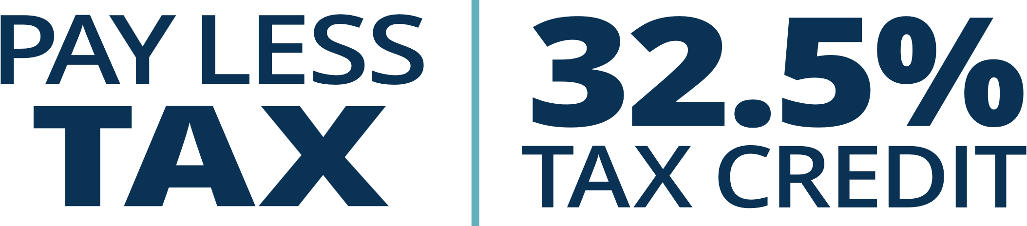

Slide 2





How It Works.
Notes:
$100 investment GOF vs reg RRSP –
Reg = 52.50 net cost
GOF = $20 net cost
MAX =$5,000 per year..
You also need to know there is a 8 year hold period on the money you invest in the Fund. The 8 year old period is required to allow the company we invest your money in to grow and meet all of the objectives in the company’s business plan.
However, If something untoward happens to your personal financial situation you can withdraw all of your contributions but you have to pay back the Tax Credits and pay income tax on the RRSP portion.

Slide 3
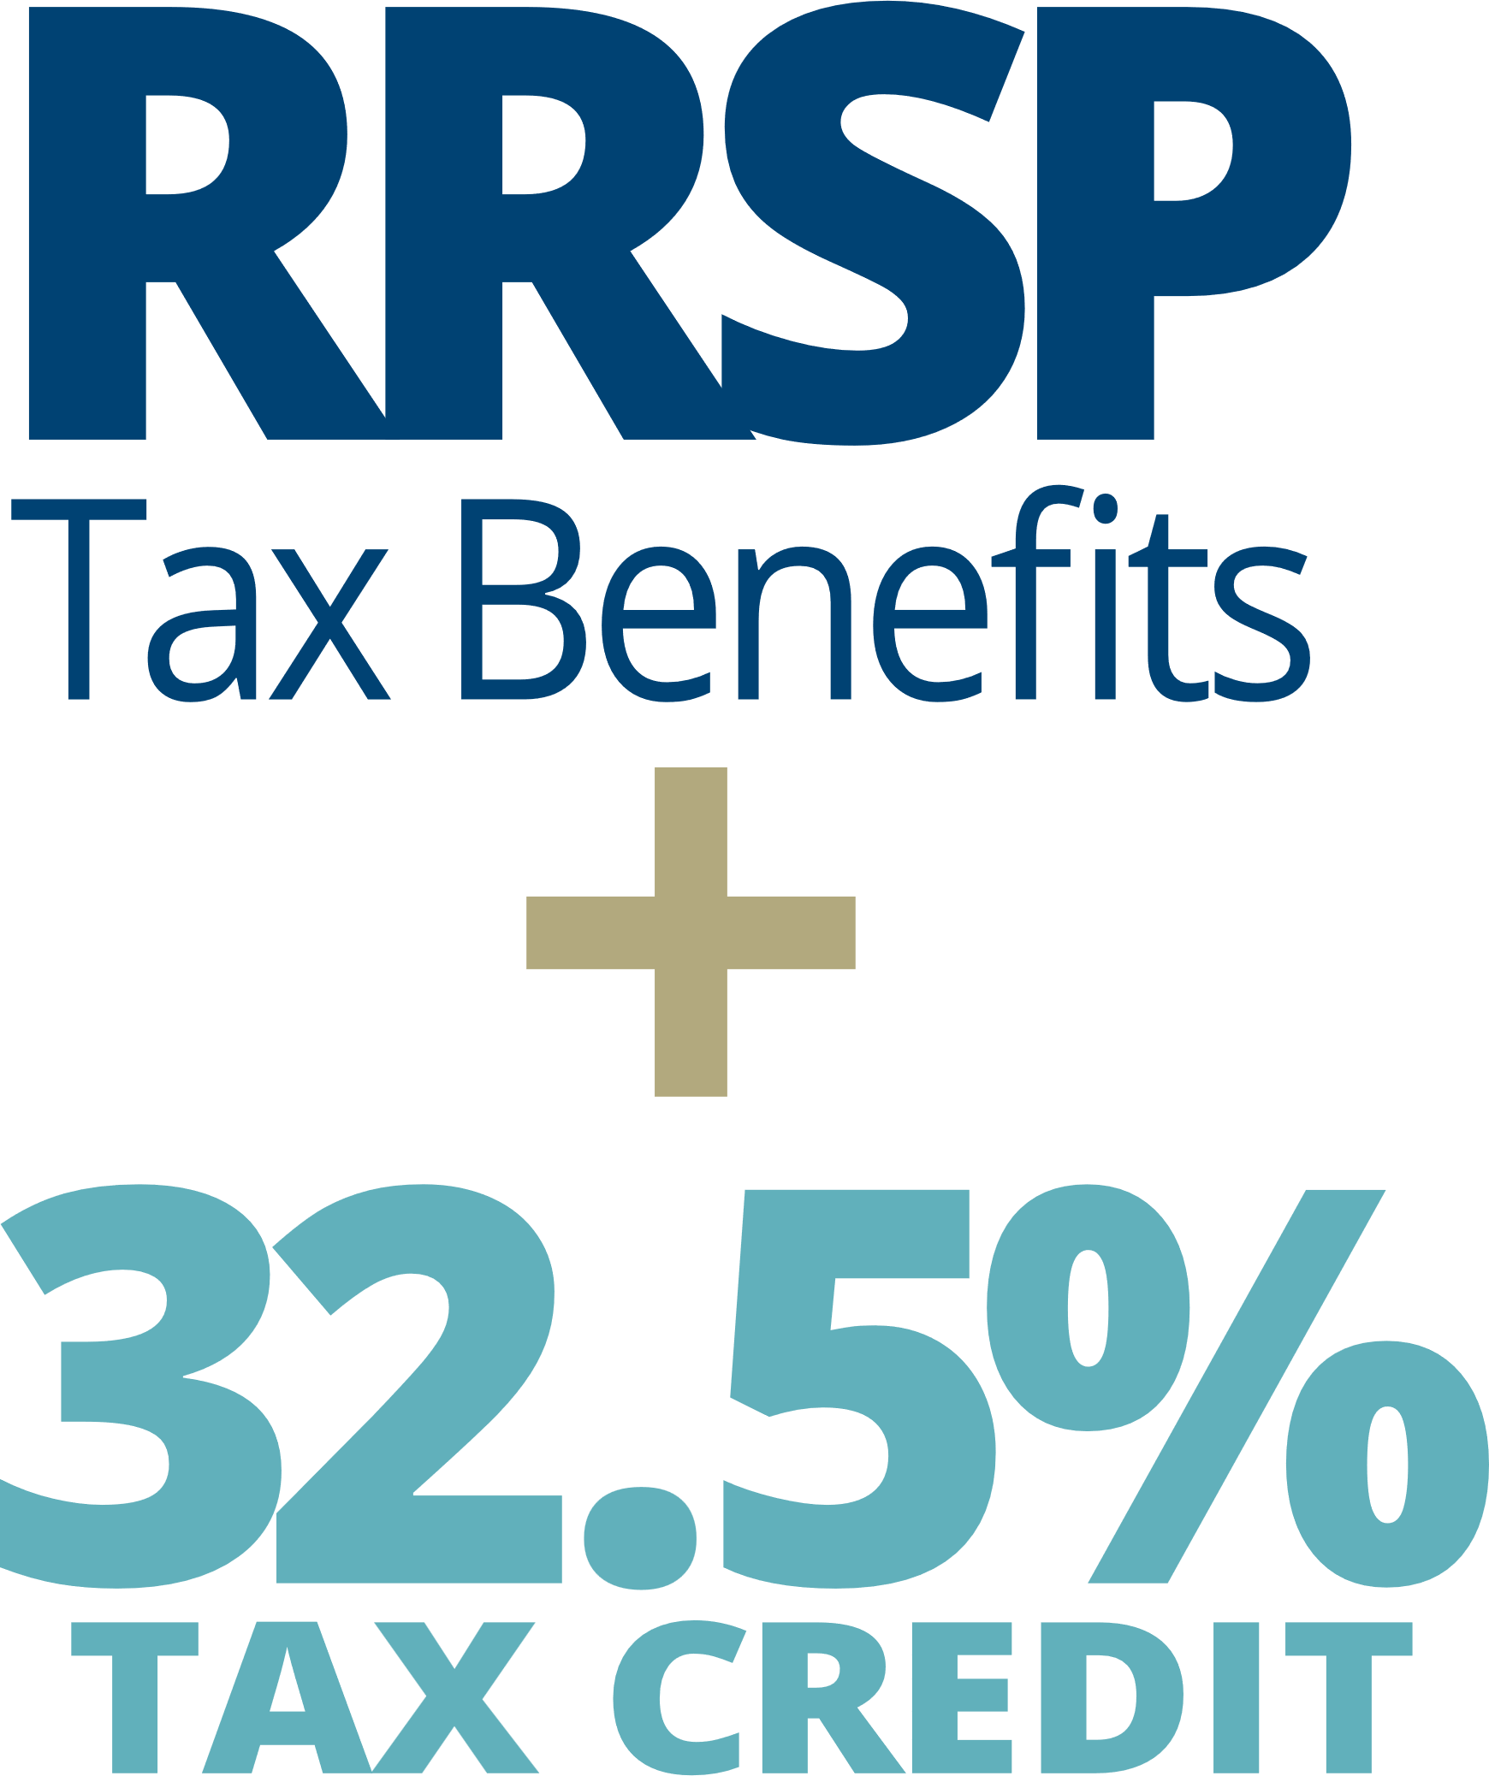
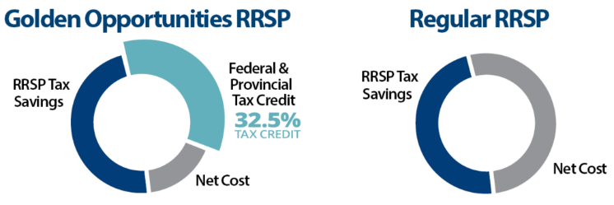
Pay Less Tax.

Slide 4
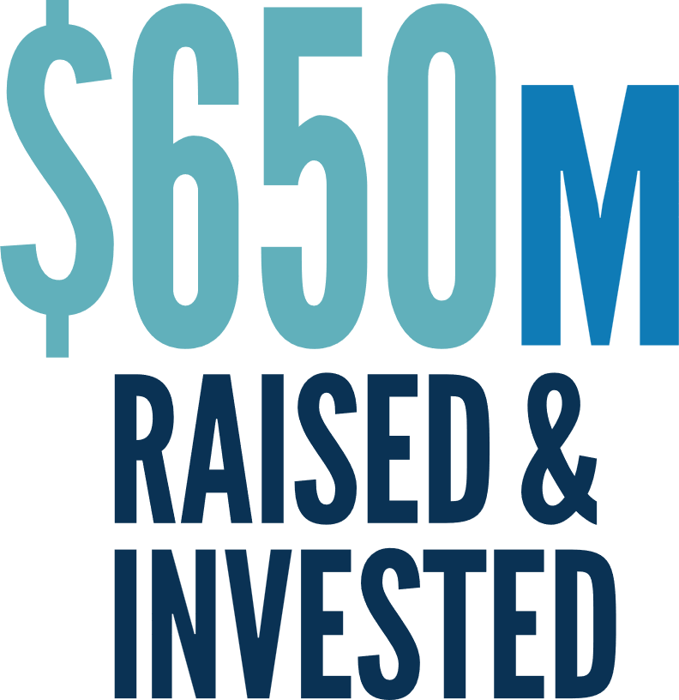
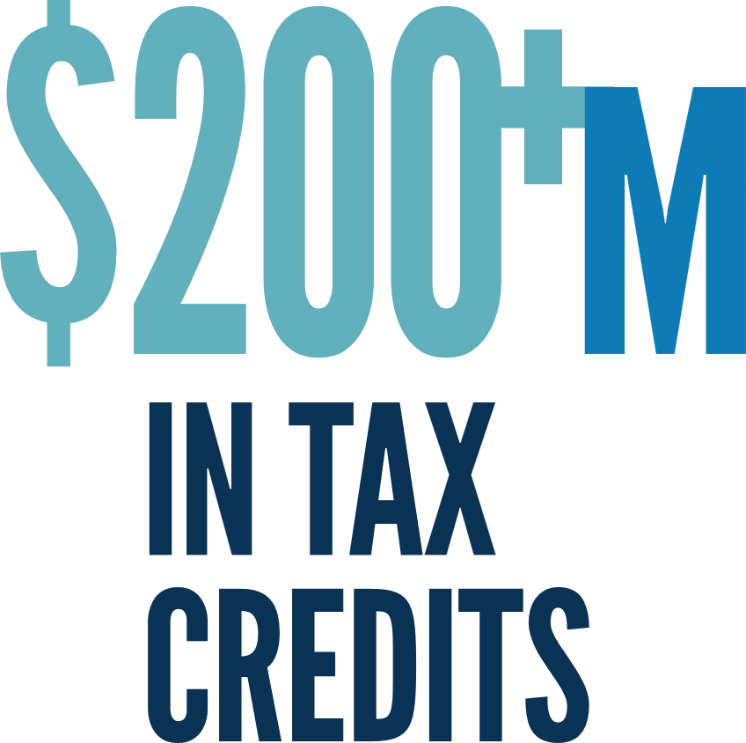

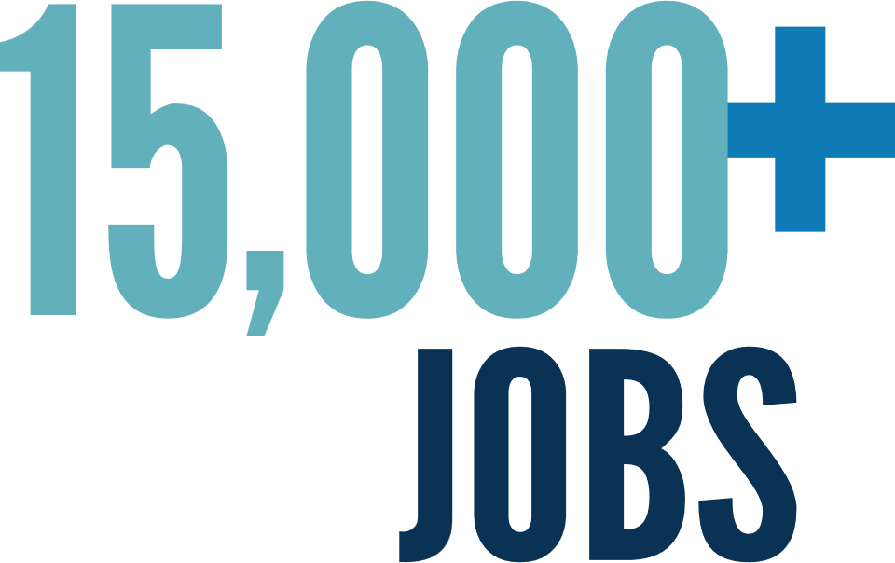

Positive Impact

Slide 5


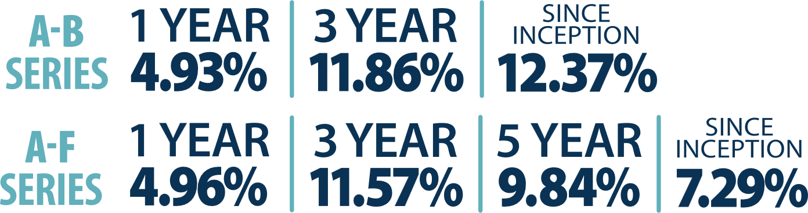
*Class A-share A-F Series based on 3 year and 5 year returns, and A-B Series based on 3 year, and since inception returns, as at February 28, 2025 per Fundata.

Slide 6









Focused Investment Thesis
7 Decades
6 Decades
2 Decades
3 Decades
5 Decades
4 Decades
4 Decades
2 Decades
4 Decades
Sample portfolio companies shown. Companies will vary depending on share class.

Slide 7

Payroll Plan

Slide 8


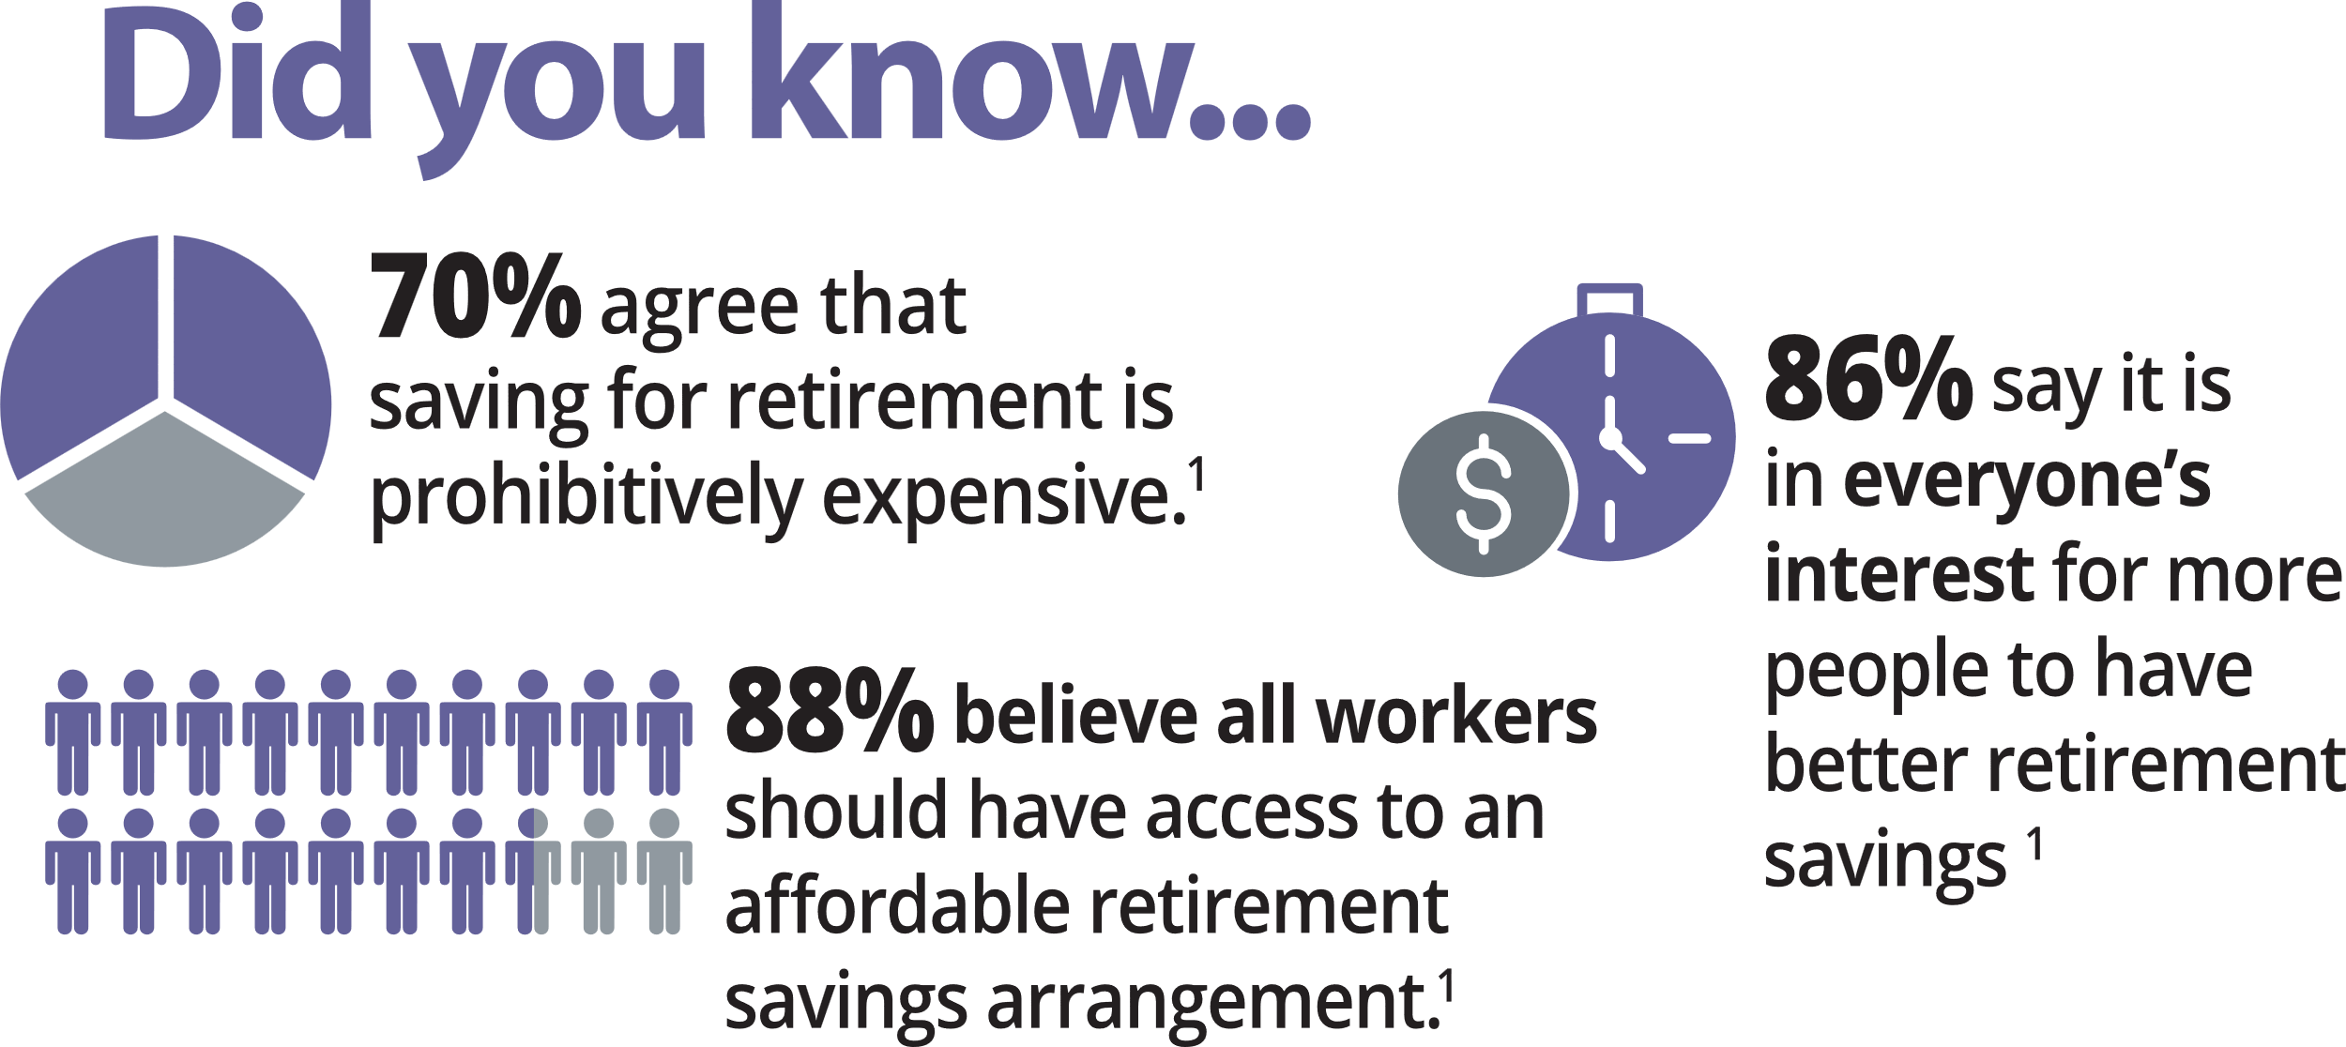

¹ Hoopp.com - Canadian Retirement Survey 2024

Slide 9
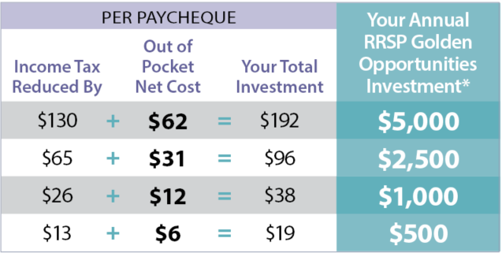
Business Owners
^{Flexible Contributions}
Not all employees have to participate and
seasonal employees are eligible
^{No Cost to an Employer}
Deduction code is set up in existing payroll platform
^{Easy to Administer}
Full support from Golden Opportunities to set up
*By combining the provincial and federal tax credits with the RRSP tax savings attached to the Fund, a bi-weekly contribution can result in an annual RRSP investment as depicted in the table above, based on 26 pay periods per year, basic personal tax exemptions and a sample marginal tax rate of 35%. Marginal tax rates vary per individual, for more information visit GoldenOpportunities.ca/Payroll-Calculator.
Notes:
We work with companies across SK to allow employees the opportunity to invest directly off their paycheque.
TOP three benefits are on the screen!
FLEXIBLE PLAN! $5,000 limit but no min.
can start your GOF contributions any time, increase or decrease the amount you wish to invest and stop your contributions any time.

Slide 10

Payroll Investment Plan
Lower Taxes Employees Pay on Every Paycheque
Receive 32.5% in tax credits PLUS RRSP Benefits.
^{Affordable}
Lower out of pocket cost = affordable retirement savings.
Easily Invest Regularly Directly off Your Paycheque
^{Remit on behalf of employees.}
Notes:
We work with companies across SK to allow employees the opportunity to invest directly off their paycheque.
TOP three benefits are on the screen!
FLEXIBLE PLAN! $5,000 limit but no min.
can start your GOF contributions any time, increase or decrease the amount you wish to invest and stop your contributions any time.

Slide 11
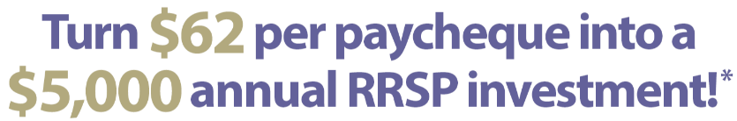
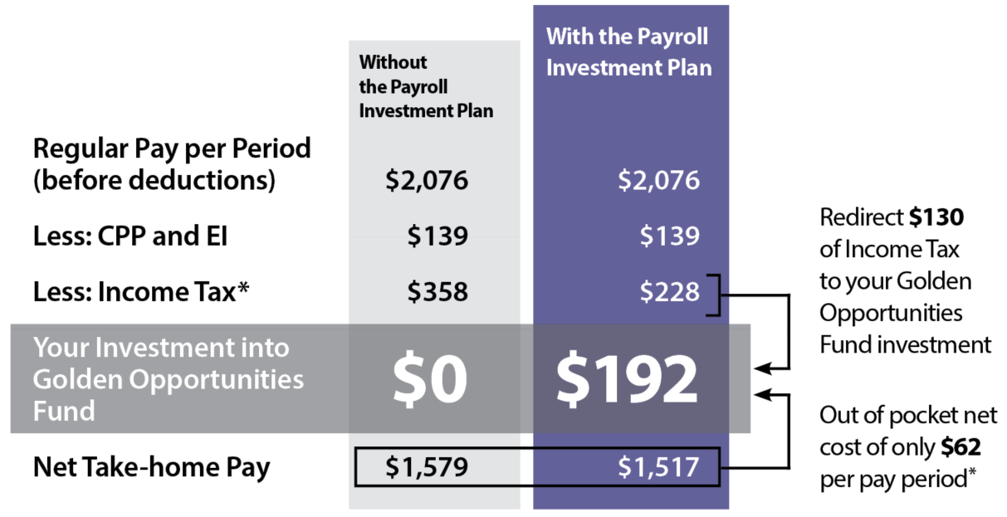
*By combining the provincial and federal tax credits with the RRSP tax savings attached to the Fund, a bi-weekly contribution of $62 can result in an annual RRSP investment of $5,000 based on 26 pay periods per year, basic personal tax exemptions and a sample marginal tax rate of 35%. Marginal tax rates vary per individual; for more information visit GoldenOpportunities.ca/Payroll-Calculator.

Slide 12

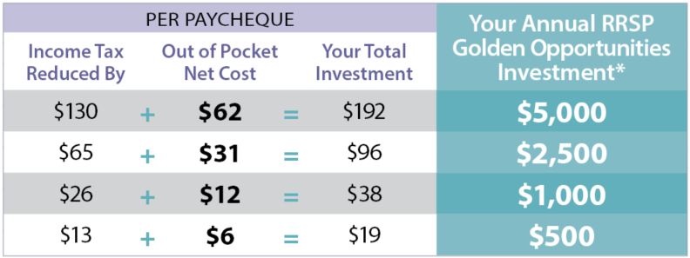
How much are you paying in income tax?
*By combining the provincial and federal tax credits with the RRSP tax savings attached to the Fund, a bi-weekly contribution can result in an annual RRSP investment as depicted in the table above, based on 26 pay periods per year, basic personal tax exemptions and a sample marginal tax rate of 35%. Marginal tax rates vary per individual, for more information visit GoldenOpportunities.ca/Payroll-Calculator.
Notes:
IS this something you pay attention to?
It is tax time! Look at your notice of assessment from last year… has your accountant pointed out this is an issue?
WE ALL HAVE TO PAY TAXES ANYWAY
FLEXIBLE: Lower or higher amount than $5,000
With a traditional RRSP contribution method you would need to save $192 per pay check in order to make a lump sum contribution of $5,000.
When you submit your tax return you would see the regular RRSP tax credit of $1,650.

Slide 13
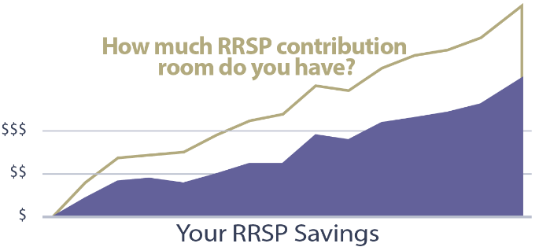
RRSP Contribution Room
You can save 18% of your pre-tax earned income in an RRSP annually.
You can carry forward all unused room in your RRSP.

Slide 14

Non-Registered Accounts
^{Is an RRSP not a good fit?}
Invest in Golden Opportunities PIP through a Non-Registered Account and still receive 32.5% in tax credits.

Slide 15

4 Steps to Get Started.

Slide 16
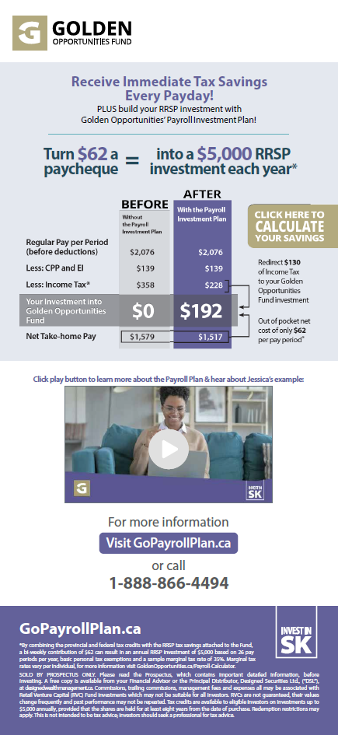
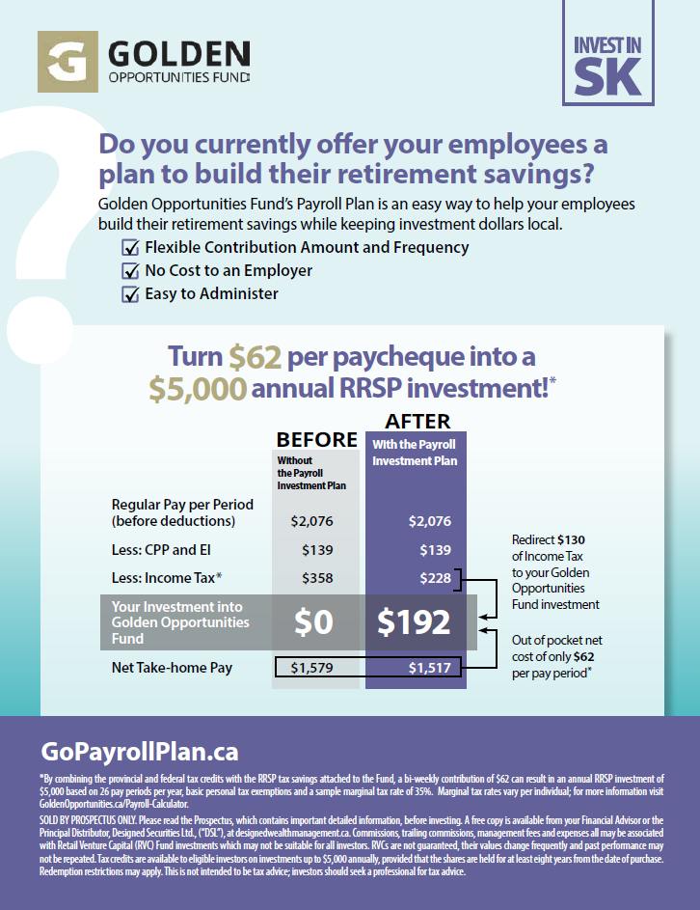
1. Advisor Introduction to Employer

Slide 17

2. Employer Discovery
Communication
Current RRSP
Team Meeting
Employee Base

Slide 18

3. Set-up & Test
Pay Period
Payroll Platform
Administrator
Remittance List

Slide 19


4. Employee Presentation
& Communication
Notes:
Consistency is key!

Slide 20

Support From the Fund
Lunch & Learn Presentations
Onsite Brochures & Posters
Email Communications
Paystub Communications
Website Banners
Notes:
One item we hear a lot that can separate us out from other Funds! Service we can provide as a local Fund Manager is a step above other larger offices – all fish are big fish to us!
Shareholder Account Information
Electronic T2Cs
Maturity Lists
Online Calculator
Investee Videos
Online Advisor Materials

